Slide 1
创建一个用户

Slide 2
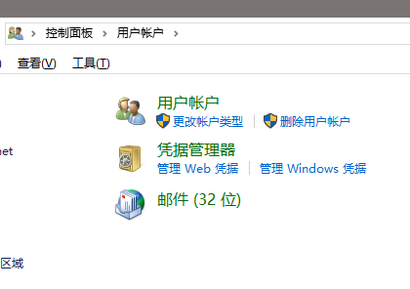
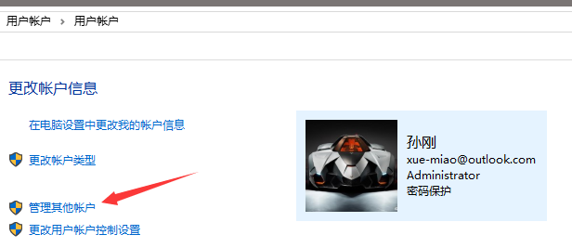

Slide 3
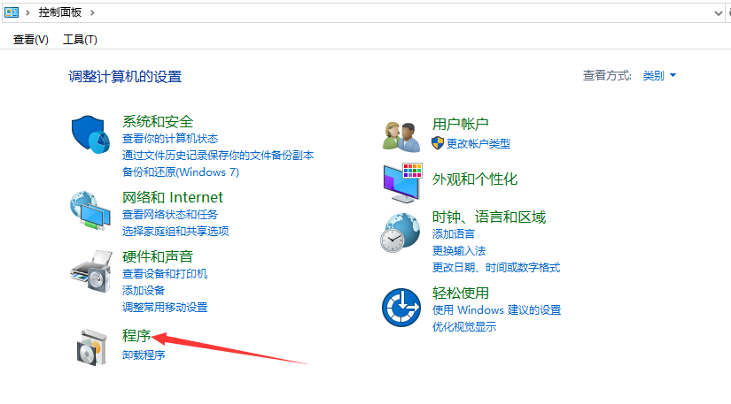

Slide 4
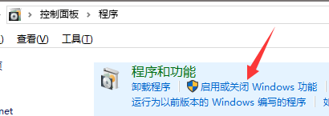
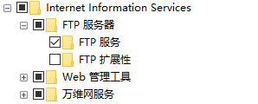


Slide 5
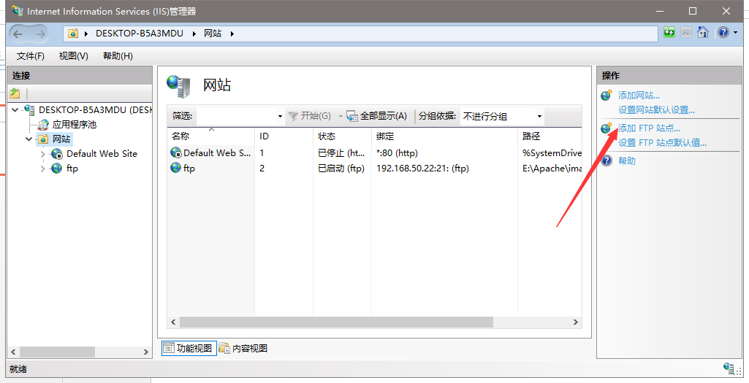

Slide 6
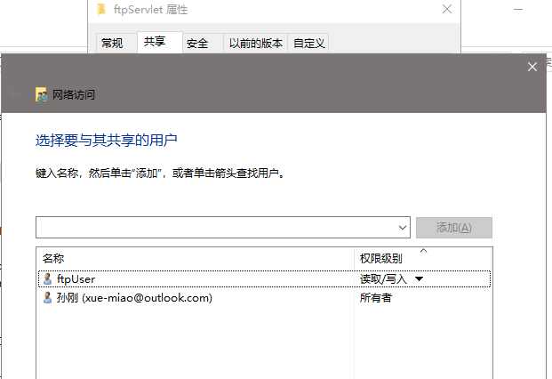

Slide 7
应用服务器
图片服务器
服务请求
图片等静态资源请求
用户

Slide 8
ftp上传或下载代码
2.上传
public boolean upload(String pathname,String fileName,
InputStream inputStream) throws IOException {
int replyCode = ftp.getReplyCode();
if (!FTPReply.isPositiveCompletion(replyCode)) {
return false;
}
ftp.setFileType(FTPClient.BINARY_FILE_TYPE);
ftp.makeDirectory(pathname);
ftp.changeWorkingDirectory(pathname);
ftp.storeFile(fileName, inputStream);
ftp.logout();
return true;
}
1.连接ftp服务器
FTPClient ftp = new FTPClient();
ftp.connect("192.168.50.22",21);
boolean login = ftp.login("ftpUser", "123321");

Slide 9
public void down(String pathname,String filename, String localpath) throws IOException {
ftp.changeWorkingDirectory(pathname);
FTPFile[] ftpFiles = ftp.listFiles();
for (FTPFile file : ftpFiles) {
if (filename.equalsIgnoreCase(file.getName())) {
File localFile = new File(localpath + "/" + file.getName());
OutputStream os = new FileOutputStream(localFile);
ftp.retrieveFile(file.getName(), os);
os.close();
break;
}
}
ftp.logout();
}

Slide 10
Controller代码
@RequestMapping("/testftp/Upload")
public String ftpUpload(@RequestParam("file") MultipartFile file,String token,HttpSession session) throws IOException {
if (!file.isEmpty()) {
String filename = file.getOriginalFilename();
InputStream inputStream = file.getInputStream();
boolean login = ftpUtils.connectFTP();
if(login){
boolean test = ftpUtils.upload("test", filename, inputStream);
if(test){
return "/success.jsp";
}
}
}
return "redirect:/faild.html";
}

